Slide 1
Practical Byzantine Fault Tolerance

Slide 2
Reasons for creation
Malicious attacks and software errors can cause faulty nodes to exhibit arbitrary behavior (and not just stop working entirely)
Previous algorithms assumed synchronous system or were too slow in production environments

Slide 3

About PBFT
Does not assume that nodes in the distributed system are not faulty
Works in asynchronous services where time is not a critical factor
Consider $n$ replicas (identical systems), at most $\left\lfloor \frac{n−1}{3}\right\rfloor$ can be simultaneously faulty for the system to work

Slide 4


Current systems
1
Clients sends a request to the distributed systems
2
System replies with a result
1
2
…
Distributed systems

Slide 5
Current systems (Malicious attacker)
1
System is affected by attacker
Due to distributed services, all systems become infected as well
2
…
2
1
Distributed systems

Slide 6
Byzantine (Malicious attacker)
1
System is affected by attacker
2
Other systems will continue to operate as per normal
…
2
1
Distributed systems

Slide 7
Process (PBFT Consensus)
Request
Pre-Prepare
Prepare
Commit
Reply
Client
Replica 0
Replica 1
Replica 2
Replica 3

Slide 8
Process (PBFT Consensus)
Request
Pre-Prepare
Prepare
Commit
Reply
Client
Replica 0
(Primary)
Replica 1
Replica 2
Replica 3
(Faulty)
1) Client sends a request to the primary

Slide 9
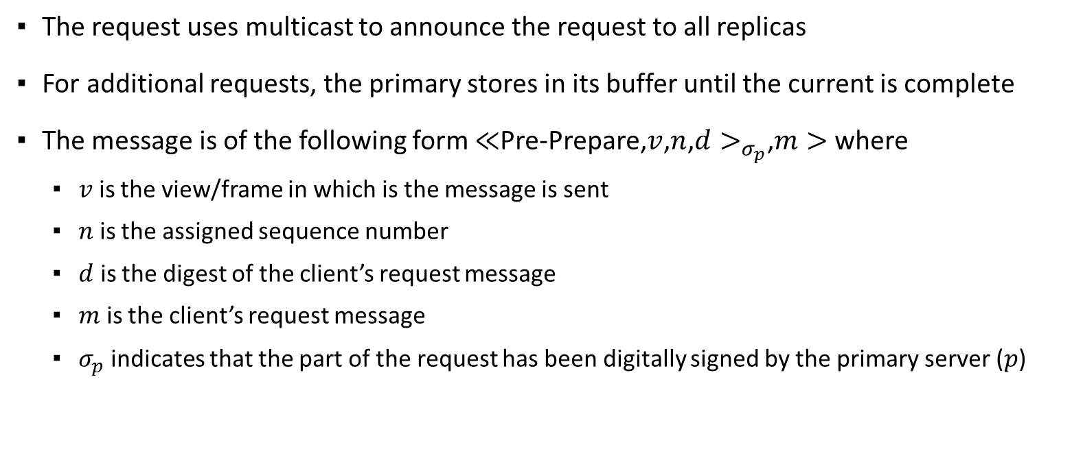
Pre-Prepare
The request uses multicast to announce the request to all replicas
For additional requests, the primary stores in its buffer until the current is complete
The message is of the following form $≪$Pre-Prepare,$v$,$n$,$d>_{σ_{p}}$,$m>$ where
$v$ is the view/frame in which is the message is sent
$n$ is the assigned sequence number
$d$ is the digest of the client’s request message
$m$ is the client’s request message
$σ_{p}$ indicates that the part of the request has been digitally signed by the primary server ($p$)

Slide 10
Process (PBFT Consensus)
Request
Pre-Prepare
Prepare
Commit
Reply
Client
Replica 0
(Primary)
Replica 1
Replica 2
Replica 3
(Faulty)
2) Pre-prepare stage multicasts requests to other replicas

Slide 11
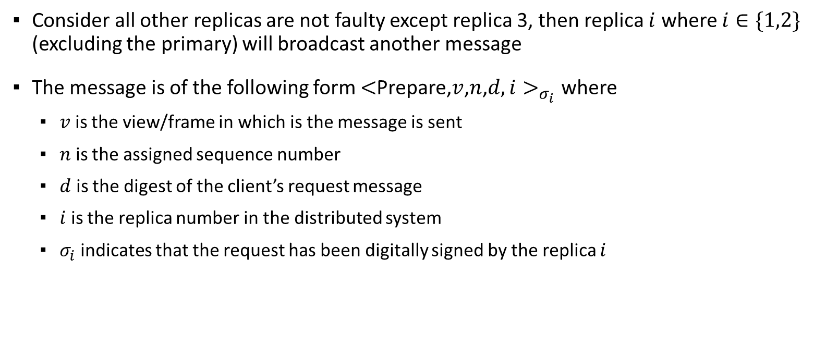
Prepare
Consider all other replicas are not faulty except replica 3, then replica $i$ where $i∈\{1,2\}$ (excluding the primary) will broadcast another message
The message is of the following form $<$Prepare,$v$,$n$,$d,i>_{σ_{i}}$ where
$v$ is the view/frame in which is the message is sent
$n$ is the assigned sequence number
$d$ is the digest of the client’s request message
$i$ is the replica number in the distributed system
$σ_{i}$ indicates that the request has been digitally signed by the replica $i$

Slide 12
Process (PBFT Consensus)
Request
Pre-Prepare
Prepare
Commit
Reply
Client
Replica 0
(Primary)
Replica 1
Replica 2
Replica 3
(Faulty)
3) Replicas multicast prepare message to other replicas
Notes:
Store message, then store request $m$ from pre-prepare view $v$ and sequence number $n$ in its logs and $2f$ prepare messages that match its pre-prepare

Slide 13

Post-Prepare
The broadcasted message by other replicas will be added to the logs of the respective replicas if the signatures are correct.
A $prepared(m,v,n,i)$ message is true if and only if replica $i$, where $i∈\{0,1,2\}$ has stored the request $m$ from pre-prepare view $v$ and sequence number $n$ in its logs and $2f$ ($f$ represents the number of faulty replicas) prepares from different backups that match its respective pre-prepares.

Slide 14
Process (PBFT Consensus)
Request
Pre-Prepare
Prepare
Commit
Reply
Client
Replica 0
(Primary)
Replica 1
Replica 2
Replica 3
(Faulty)
4) A commit message is multicasted to other replicas

Slide 15
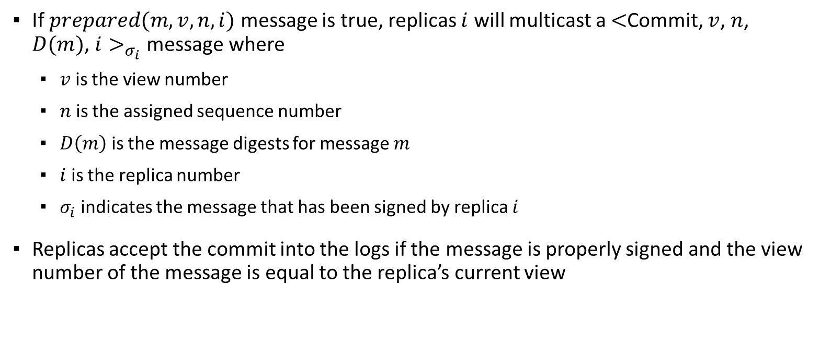
Commit
If $prepared(m,v,n,i)$ message is true, replicas $i$ will multicast a $<$Commit, $v$, $n$, $D(m)$, $i>_{σ_{i}}$ message where
$v$ is the view number
$n$ is the assigned sequence number
$D\left(m\right)$ is the message digests for message $m$
$i$ is the replica number
$σ_{i}$ indicates the message that has been signed by replica $i$
Replicas accept the commit into the logs if the message is properly signed and the view number of the message is equal to the replica’s current view

Slide 16
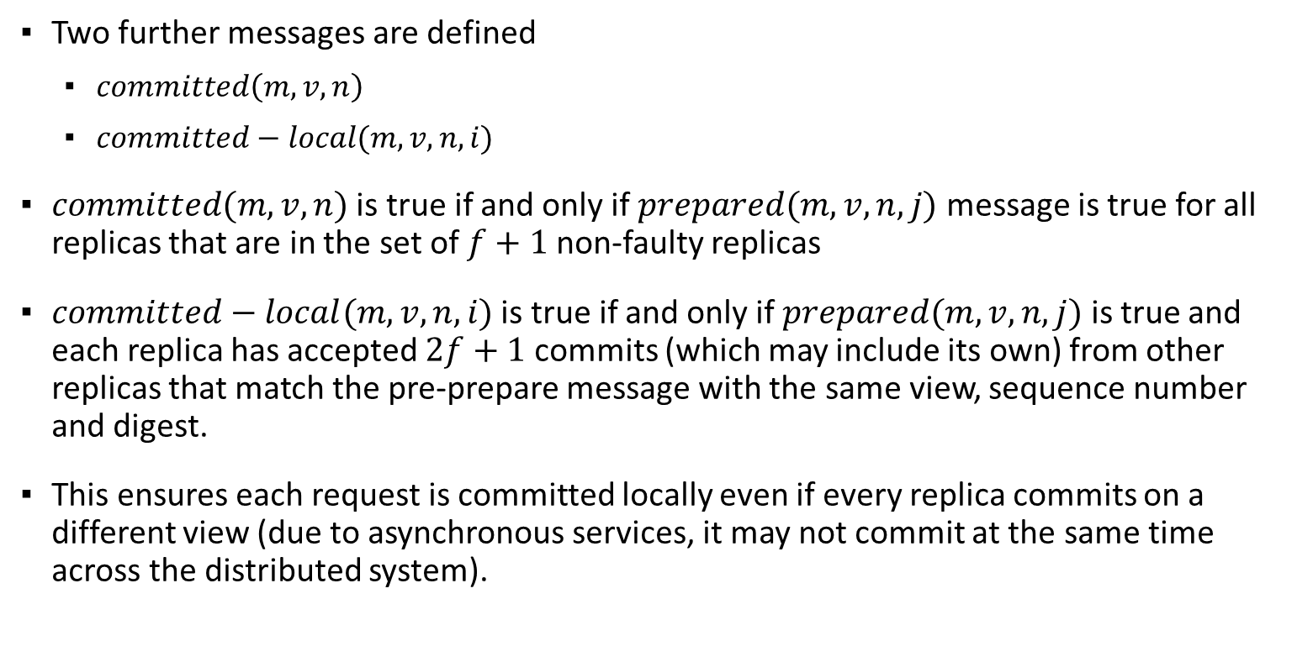
Commit
Two further messages are defined
$committed\left(m,v,n\right)$
$committed−local(m,v,n,i)$
$committed(m,v,n)$ is true if and only if $prepared(m,v,n,j)$ message is true for all replicas that are in the set of $f+1$non-faulty replicas
$committed−local(m,v,n,i)$ is true if and only if $prepared(m,v,n,j)$ is true and each replica has accepted $2f+1$ commits (which may include its own) from other replicas that match the pre-prepare message with the same view, sequence number and digest.
This ensures each request is committed locally even if every replica commits on a different view (due to asynchronous services, it may not commit at the same time across the distributed system).

Slide 17
Process (PBFT Consensus)
Request
Pre-Prepare
Prepare
Commit
Reply
Client
Replica 0
(Primary)
Replica 1
Replica 2
Replica 3
(Faulty)
5) Completion of request sent back to client

Slide 18
Commit
After the request has been committed, it is sent back to the client

Slide 19
Process (PBFT Consensus) Replica that client connects to is faulty
Request
Pre-Prepare
Prepare
Commit
Reply
Client
Replica 0
(Faulty Primary)
Replica 1
Replica 2
Replica 3
1) Client will send a request to the replica still

Slide 20

Faulty replica
A backup primary has a timer for when the request is sent by the client.
If the backup primary does not receive a multicast request within time $h$, the original primary is assumed faulty and the client will try again on the next assumed primary.

Slide 21
Process (PBFT Consensus) Replica that client connects to is faulty
Request
Pre-Prepare
Prepare
Commit
Reply
Client
Replica 0
(Faulty Primary)
Replica 1
(Backup Primary)
Replica 2
Replica 3
2) Client will send a request to the new primary

Slide 22
Process (PBFT Consensus) Replica that client connects to is faulty
Request
Pre-Prepare
Prepare
Commit
Reply
Client
Replica 0
(Faulty Primary)
Replica 1
(Backup Primary)
Replica 2
Replica 3
3) The process will proceed as per normal

Slide 23
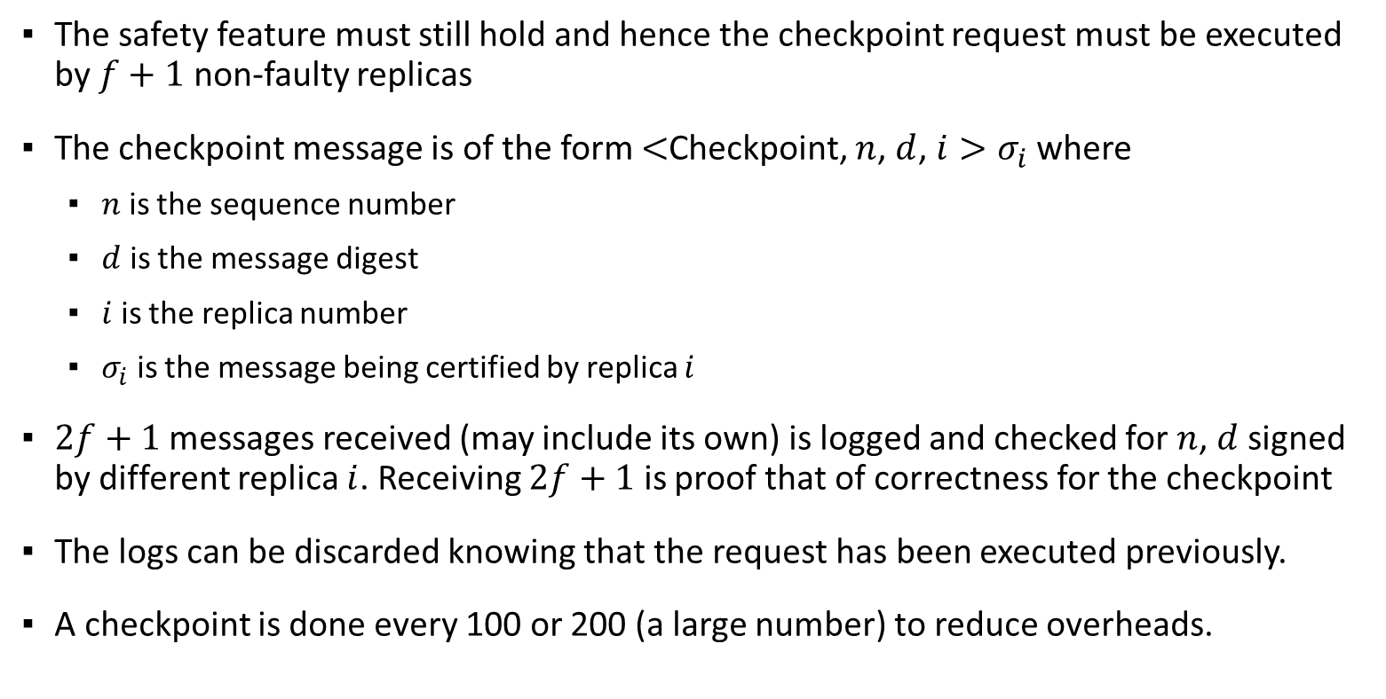
Clearing logs (Checkpoint)
The safety feature must still hold and hence the checkpoint request must be executed by $f+1$ non-faulty replicas
The checkpoint message is of the form $<$Checkpoint, $n$, $d$, $i>σ_{i}$ where
$n$ is the sequence number
$d$ is the message digest
$i$ is the replica number
$σ_{i}$ is the message being certified by replica $i$
$2f+1$ messages received (may include its own) is logged and checked for $n$, $d$ signed by different replica $i$. Receiving $2f+1$ is proof that of correctness for the checkpoint
The logs can be discarded knowing that the request has been executed previously.
A checkpoint is done every 100 or 200 (a large number) to reduce overheads.
Notes:
n: sequence number
d: digest of checkpoint message

Slide 24
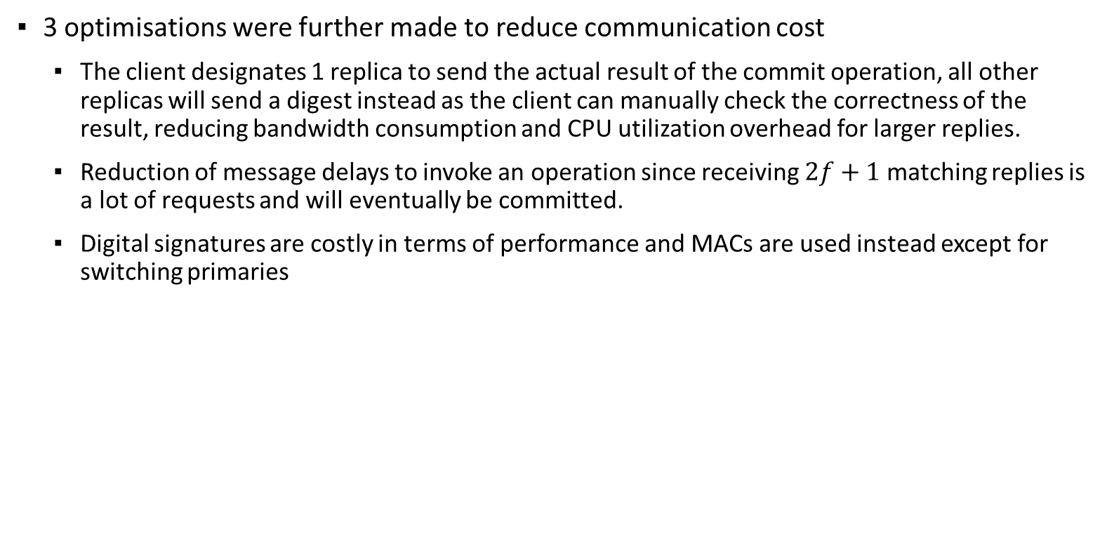
Optimisations
3 optimisations were further made to reduce communication cost
The client designates 1 replica to send the actual result of the commit operation, all other replicas will send a digest instead as the client can manually check the correctness of the result, reducing bandwidth consumption and CPU utilization overhead for larger replies.
Reduction of message delays to invoke an operation since receiving $2f+1$ matching replies is a lot of requests and will eventually be committed.
Digital signatures are costly in terms of performance and MACs are used instead except for switching primaries
Notes:
Reduction of message delays: 5 to 4
MACs: Message Authentication Codes

Slide 25
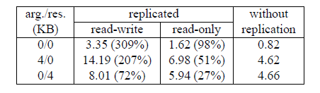
Performance Benchmarks
A null operation with arguments and results (arg/res) were obtained.
The replicated systems were slower than the system without replication due to overhead by the replication library creating extra computational steps and communication, which included cryptographic operations.
This also resulted in communication of larger messages and hence higher duration required.
Notes:
All in milliseconds (ms)

